Slide 1

AI-Powered LED Lighting Optimization
By Killing Data

Slide 2
AI-Powered LED Lighting Optimization
Our application leverages Gen AI to balance natural and artificial light. It creates optimal LED brightness plans based on sensor data.
Energy consumption reduced by up to 50% compared to traditional systems.

Slide 3

Inefficient Systems Traditional lighting fails to adapt to changing conditions
Manual Overrides
Human adjustments lead to over-illumination
Energy Waste
Commercial buildings waste 30% of energy on lighting
Global Impact
Lighting accounts for 17% of worldwide electricity consumption
The Lighting
Challenge

Slide 4

Our Approach: The AI Advantage
Data Collection
Real-time analysis via light sensors
AI Processing
Machine learning predicts optimal lighting needs
Pattern Recognition
System learns from historical natural light data
Dynamic Adjustment
LED brightness adapts to environmental factors

Slide 5

The Solution Architecture
Sensor Network
Captures ambient light data across spaces
AI Core
Processes patterns and real-time conditions
User Interface
Provides monitoring and manual overrides
Maintenance
Predicts system optimization needs

Slide 6
Dashboard Features Live Metrics
Energy usage tracking
Cost analysis
Brightness levels
Data Visualization
Processed data tables
AI-generated schedules
Trend analysis
Manual Controls
Override capabilities
Real-time status
Timestamp monitoring

Slide 7
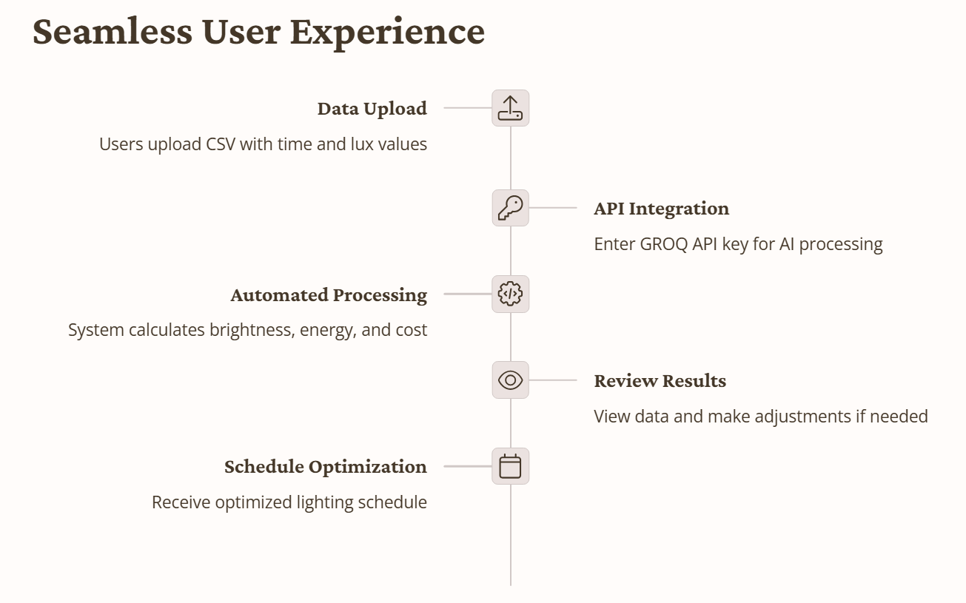
User Flow

Slide 8
Tech Stack Used
Data Input
CSV files with timestamp and lux values from sensors
AI Processing
GROQ API integration for intelligent lighting schedules
User Interface
Streamlit dashboard for insights and control

Slide 9

Thank You

